Slide 1
Modeling Cyberphysical Systems
Sayan Mitra
Verifying cyberphysical systems
mitras@illinois.edu

Slide 2
Map of CPS models
Dynamical systems
Differential inclusions
Discrete transition systems, automata
Markov chains
Probabilistic automata, Markov decision processes (MDP)
Continuous time, continuous state MDPs
Hybrid systems
Stochastic Hybrid systems

Slide 3
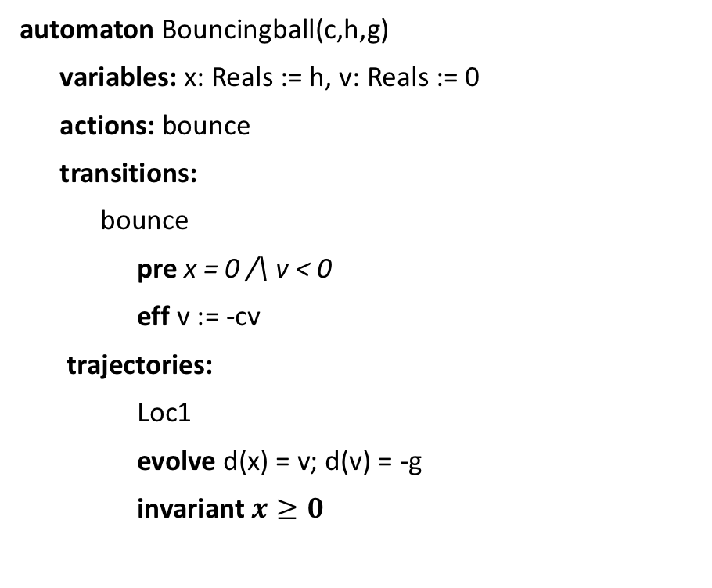
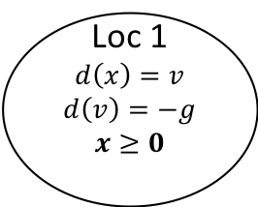
Bouncing Ball: Hello world of CPS
automaton Bouncingball(c,h,g)
variables: x: Reals := h, v: Reals := 0
actions: bounce
transitions:
bounce
pre x = 0 /\ v < 0
eff v := -cv
trajectories:
Loc1
evolve d(x) = v; d(v) = -g
invariant $x≥0$
bounce
x = 0 /\ v < 0
v’ := -cv
Loc 1
$$d\left(x\right)=v$$
$$d\left(v\right)=−g$$
$$x≥0$$
x:= h
mode invariant, not to be confused with invariants of the automaton
Graphical Representation used in many articles
Notes:
Guard, Precondition
Effect, Reset map
Invariance

Slide 4
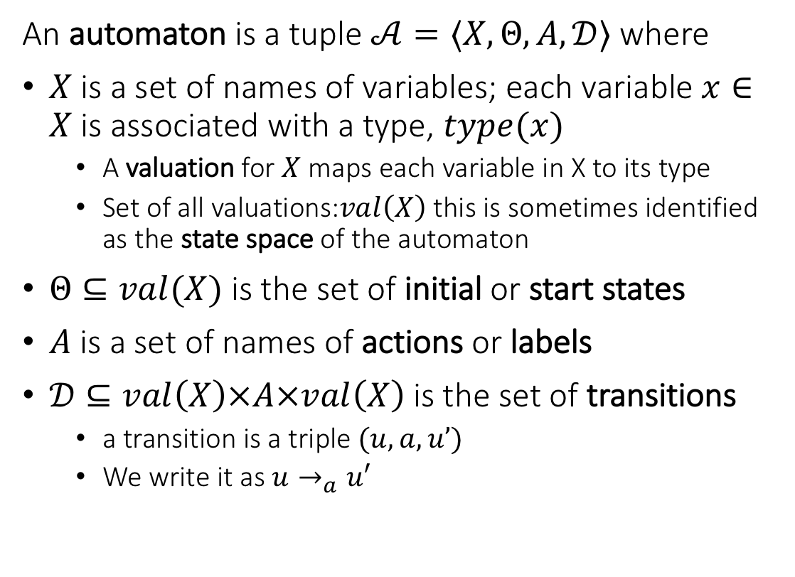
Recall from Lecture 1. language defines an automaton
An automaton is a tuple $𝒜=〈X,Θ, A, 𝒟〉$ where
$X$ is a set of names of variables; each variable $x∈X$is associated with a type, $type(x)$
A valuation for $X$ maps each variable in X to its type
Set of all valuations:$val\left(X\right)$ this is sometimes identified as the state space of the automaton
$Θ⊆val(X)$ is the set of initial or start states
$A$ is a set of names of actions or labels
$𝒟⊆val\left(X\right)×A×val\left(X\right)$ is the set of transitions
a transition is a triple $(u,a,u’)$
We write it as $u→_{a}u′$
automaton DijkstraTR(N:Nat, K:Nat), where K > N
type ID: enumeration [0,...,N-1]
type Val: enumeration [0,...,K]
actions
update(i:ID)
variables
x:[ID -> Val]
transitions
update(i:ID)
pre i = 0 /\ x[i] = x[N-1]
eff x[i] := (x[i] + 1) % K
update(i:ID)
pre i >0 /\ x[i] ~= x[i-1]
eff x[i] := x[i-1]

Slide 5
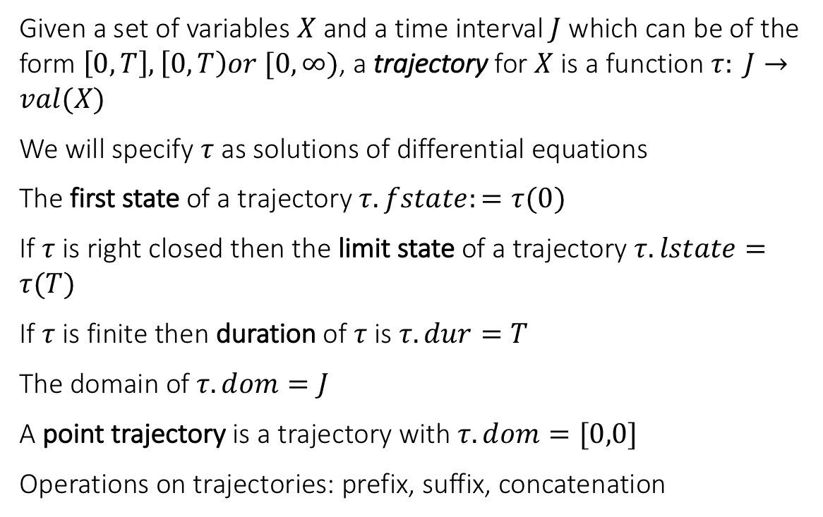
Trajectories
Given a set of variables $X$ and a time interval $J$ which can be of the form $\left[0,T\right], \left[0,T\right)or [0,∞)$, a trajectory for $X$ is a function $τ: J→val(X)$
We will specify $τ$ as solutions of differential equations
The first state of a trajectory $τ.fstate:=τ(0)$
If $τ$ is right closed then the limit state of a trajectory $τ.lstate=τ(T)$
If $τ$ is finite then duration of $τ$ is $τ.dur=T$
The domain of $τ.dom=J$
A point trajectory is a trajectory with $τ.dom=[0,0]$
Operations on trajectories: prefix, suffix, concatenation

Slide 6
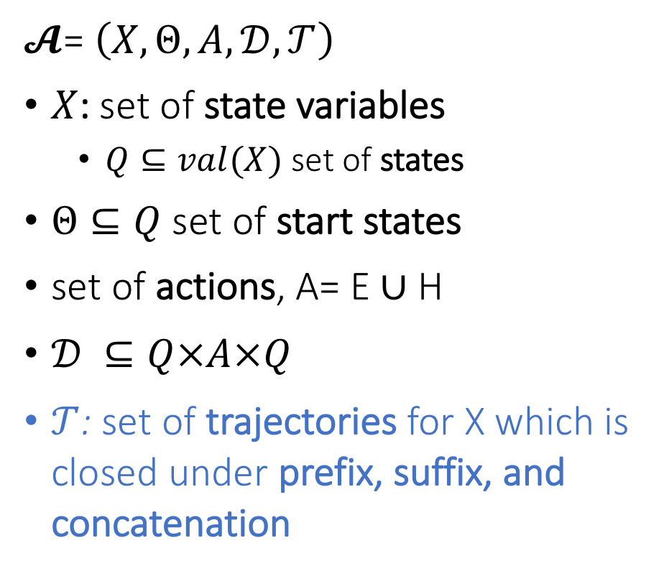
Hybrid Automaton
$𝓐$= $\left(X,Θ,A,𝒟,𝒯\right)$
$X$: set of state variables
$Q⊆val(X)$ set of states
$Θ⊆Q$ set of start states
set of actions, A= E ∪ H
$𝒟 ⊆Q×A×Q$
$𝒯$: set of trajectories for X which is closed under prefix, suffix, and concatenation
Notes:
Pick a couple of nice examples

Slide 7
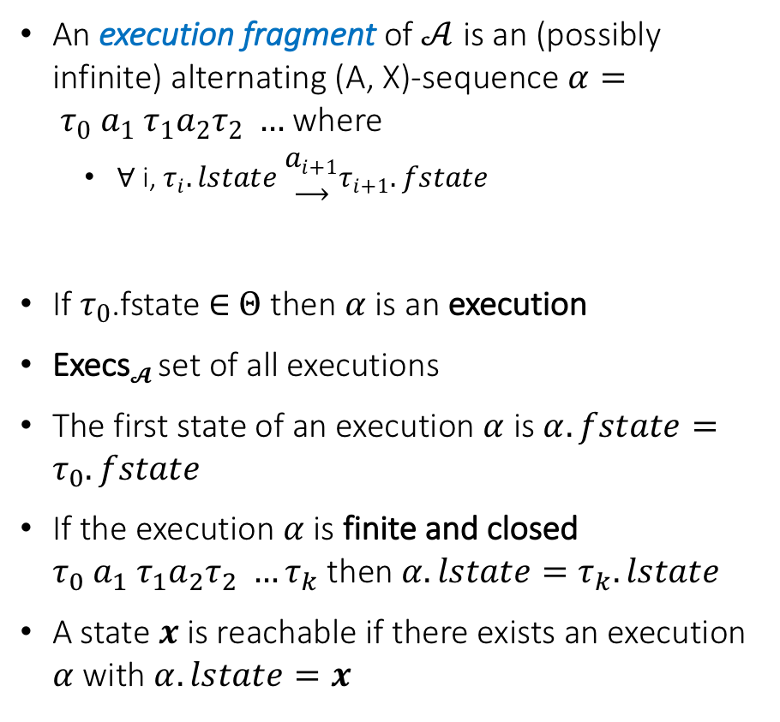
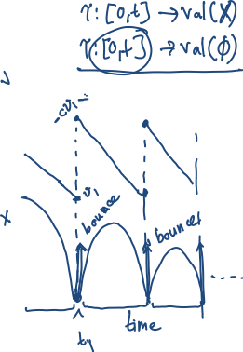
Semantics: Executions and Traces
An execution fragment of $𝒜$ is an (possibly infinite) alternating (A, X)-sequence $α= τ_{0} a_{1} τ_{1}a_{2}τ_{2} …$ where
∀ i, $τ_{i}.lstate \begin{matrix}a_{i+1} \\ ⟶\end{matrix}τ_{i+1}.fstate$
If $τ_{0}$.fstate ∈ $Θ$ then $α$is an execution
Execs$𝓐$ set of all executions
The first state of an execution $α$ is $α.fstate=τ_{0}.fstate$
If the execution $α$is finite and closed $τ_{0} a_{1} τ_{1}a_{2}τ_{2} …τ_{k}$ then $α.lstate=τ_{k}.lstate$
A state $x$is reachable if there exists an execution $α$ with $α.lstate=x$

Slide 8
Example 2: Thermostat
automaton Thermostat(u, l, K, h : Real) where u > l
type Status enumeration [on, off ] actions
turnOn; turnOff;
variables
x: Real := l loc: Status := on
transitions
turnOn
pre x≤l ∧ loc=off
eff loc := on
trajectories
modeOn
evolve d(x) = K(h − x)
invariant loc = on ∧ x ≤ u
turnOff
pre x≥u ∧ loc=on
eff loc := off
modeOff
evolve d(x) = −Kx
invariant loc = off ∧ x ≥ l
Determinism vs nondeterminism
mode invariants

Slide 9
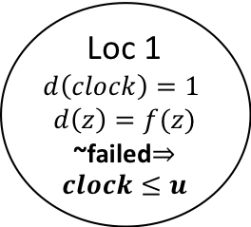
Another Example: Periodically Sending Process
Automaton PeriodicSend(u)
variables: analog
clock: Reals := 0, z:Reals, failed:Boolean := F
actions: send(m:Reals), fail
transitions:
send(m)
pre clock = u /\ m = z /\ ~failed
eff clock := 0
fail
pre true
eff failed := T
trajectories:
evolve d(clock) = 1, d(z) = f(z)
invariant ~failed \/ clock<=u
send(m)
clock = u /\ m = z /\ ~failed
clock := 0
Loc 1
$$d\left(clock\right)=1$$
$$d\left(z\right)=f(z)$$
~failed$⇒clock≤u$
clock:= 0
fail
true
failed := T

Slide 10
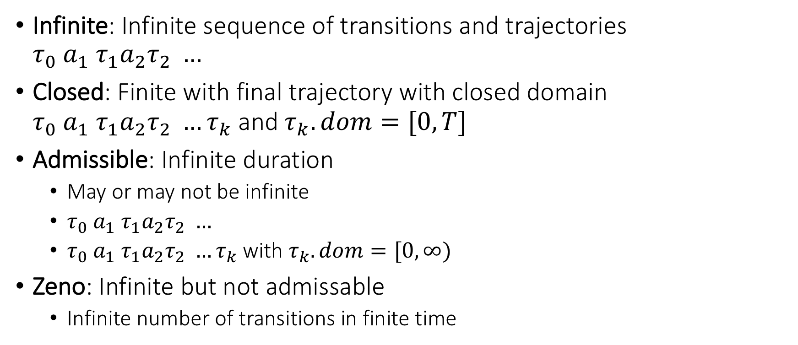
Special kinds of executions
Infinite: Infinite sequence of transitions and trajectories $τ_{0} a_{1} τ_{1}a_{2}τ_{2} …$
Closed: Finite with final trajectory with closed domain $τ_{0} a_{1} τ_{1}a_{2}τ_{2} …τ_{k}$ and $τ_{k}.dom=[0,T]$
Admissible: Infinite duration
May or may not be infinite
$τ_{0} a_{1} τ_{1}a_{2}τ_{2} …$
$τ_{0} a_{1} τ_{1}a_{2}τ_{2} …τ_{k}$ with $τ_{k}.dom=[0,∞)$
Zeno: Infinite but not admissable
Infinite number of transitions in finite time

Slide 11


Zeno’s Paradox
Achilles, the fastest athlete, greatest warrior
Zeno, Greek philosopher
whatever!
You couldn’t even beat a turtle
Achilles runs 10 times faster than than the tortoise, but the turtle gets to start 1 second earlier. Can Achilles ever catch Turtle?
Lesson: Mixing discrete transitions with continuous motion can be tricky!
After 1/10th of a second, Achilles reaches where the Turtle (T) started, and T has a head start of 1/10th second.
After another 1/100th of a second, A catches up to where T was at t=1/10 sec, but T has a head start of 1/100th
…
T is always ahead …
Notes:
5 mins.

